Slide 1
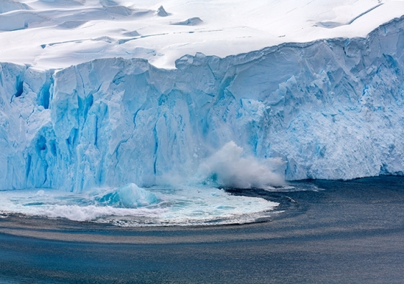
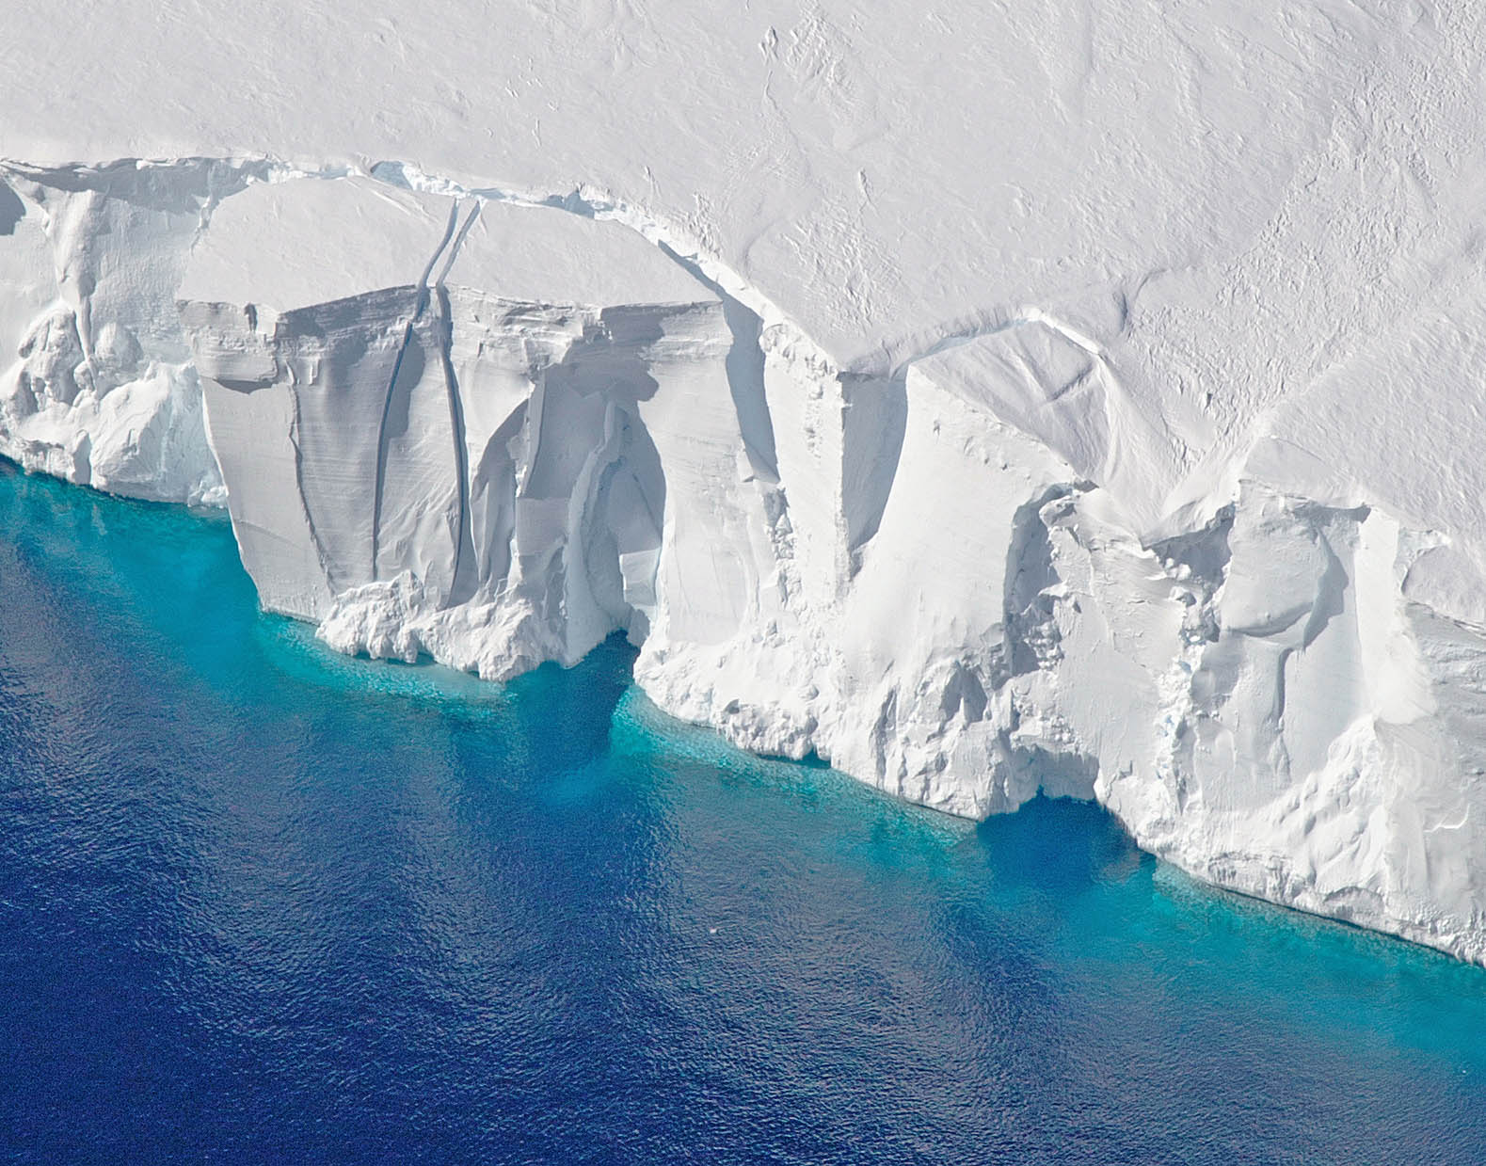
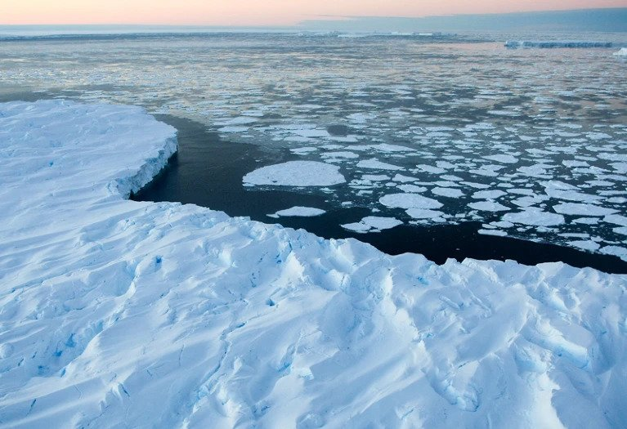
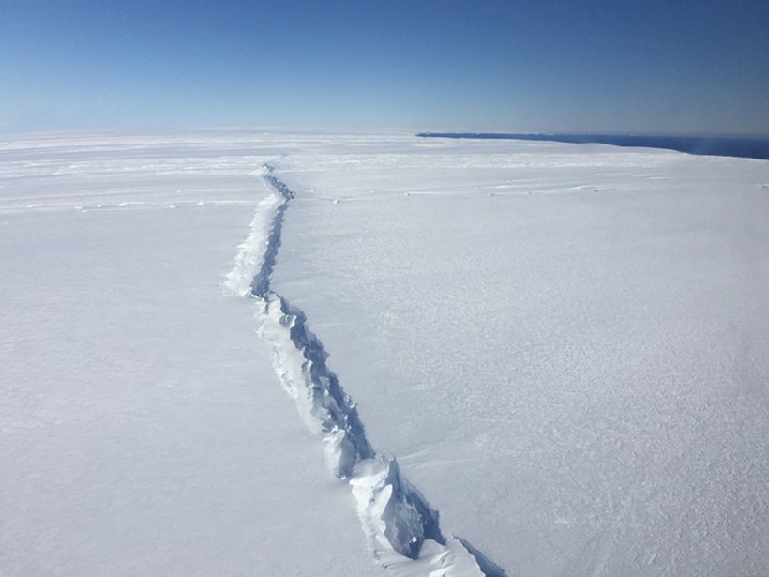
Multi-fidelity experimental design for ice-sheet models
Pierre Thodoroff

Slide 2
AGENDA
Ice-sheet models
Theoretical insights
Future directions/projects
Multi-fidelity experimental design
Applications to PDE and ice-sheet

Slide 3
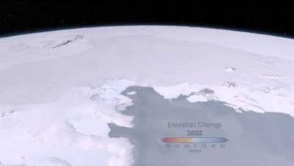
WHAT ARE Ice-sheet models?
Notes:
This is the sea we are working on.

Slide 4
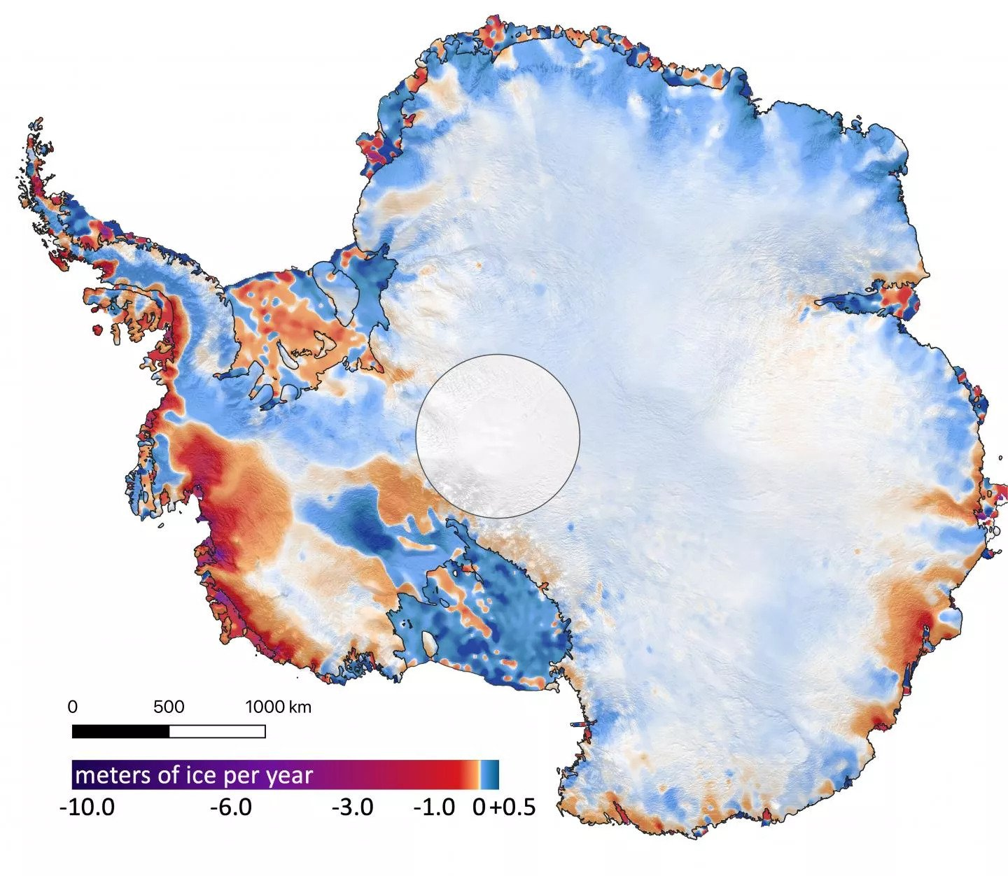
WHY ARE THEY USEFUL?
Predicting the melting of the ice-sheet and the contribution to the sea level.
Ice-sheet are not stationary ice-cubes. They move, deform and melt through time.
Interesting facts:
If all the ice melt -> 60 meters increase in sea level.
Thickness of the ice at the deepest point is approximately 15 Eiffel tower!
4

Slide 5
Modelling ice-sheet movement
Goal: predict the velocities at any spatial location in the future.
Secondary goal: predict the shape of the ice sheet.
Two components to consider:
Mass change such as the melting or accumulation of ice
Physical forces such as gravity, basal drag…
Physical model: fluid moving through time (Stokes flow)

Slide 6
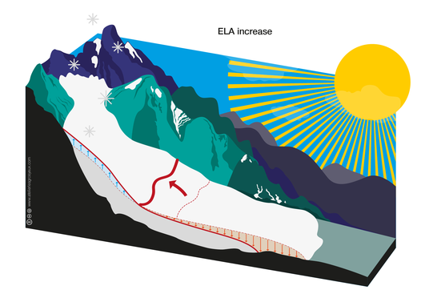
Ice-sheet 101: MASS BALANCE
Positive mass: snowfall
Negative mass: melting
Simplified model

Slide 7
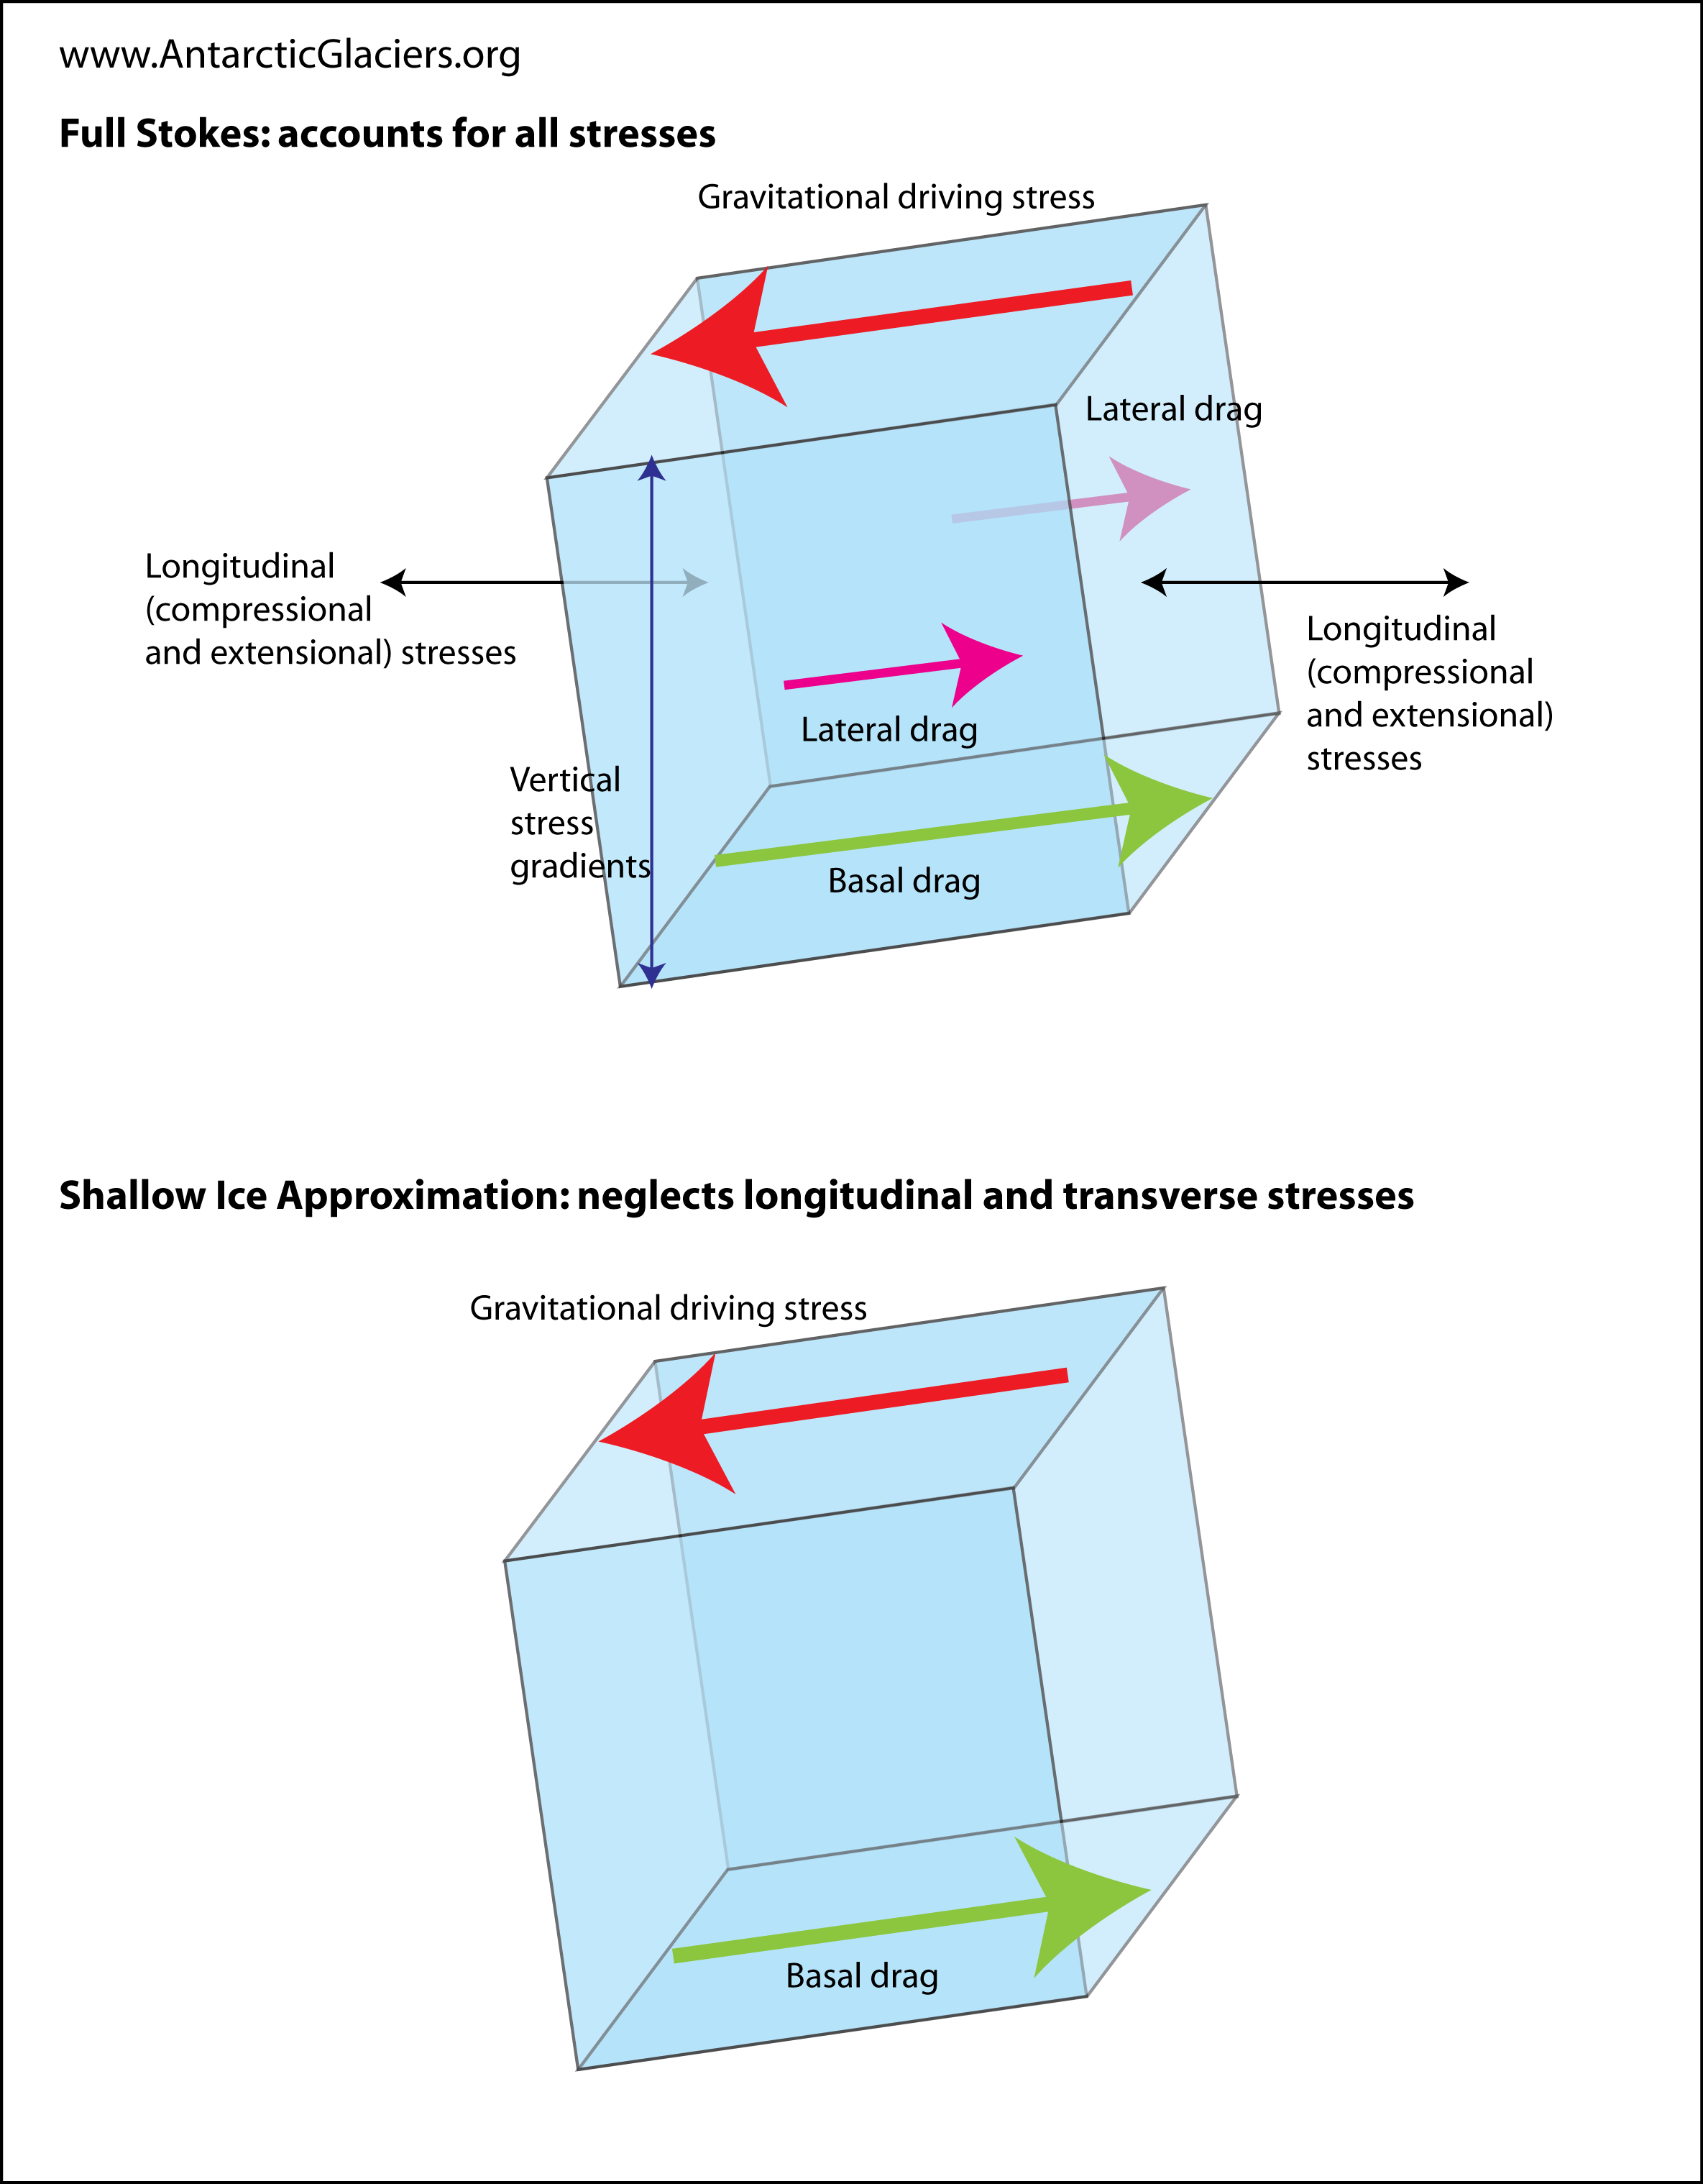
Ice-sheet 101: PHYSICAL FORCES

Slide 8
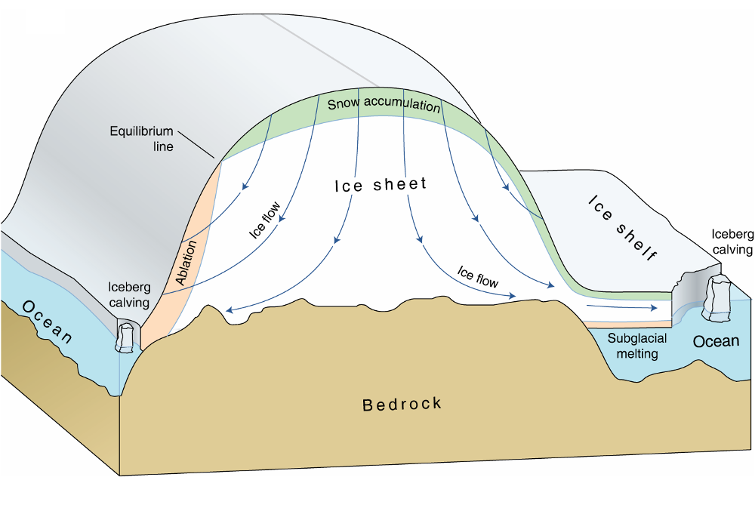
Ice-sheet 101: SUMMARY
Ice-flow downwards due to gravity
Accumulation on top
Ablation at the bottom
Bedrock (basal drag)

Slide 9
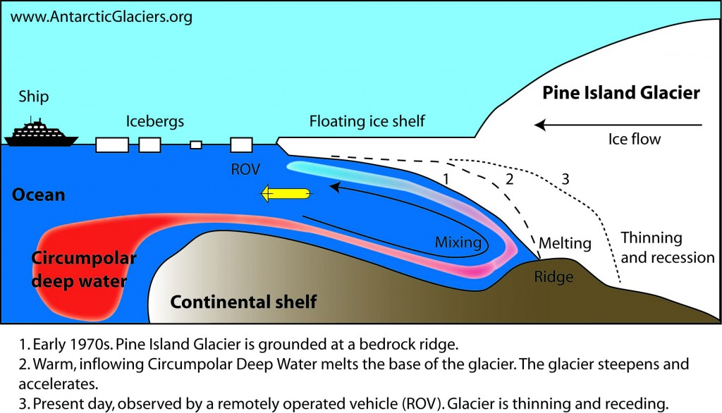
Melting of ICE

Slide 10
GoaL: predict Sea level increase
Run ice-sheet model forward for 100 years and predict the contribution to sea level (SLC).
High uncertainty over many parameters: bedrock, precipitation, melting rate...
Run the models over various input parameters.
Probabilistic estimate of increase in sea level.

Slide 11
Computational constraints
Unknown bed rock (basal drags), physical constraints and various forces to consider make simulation hard and expensive (inverse problem).
Running high resolution models (small grids) can take several weeks.
Required to run the model over various initial states and parameter.

Slide 12
Computational optimization
Numerical solvers relies on temporal discretization to solve differential equations (no closed form solution).
Computational costs is dependant on the resolution used.
How small should my grid be to properly estimate the contribution to sea level?
Talk: optimize the utility/cost ratio of running the simulator.

Slide 13
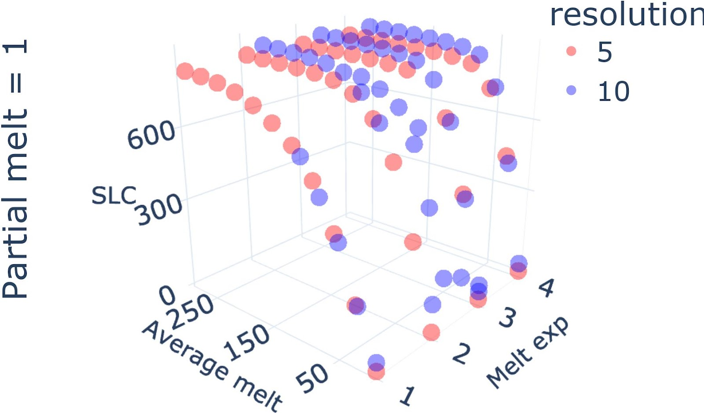
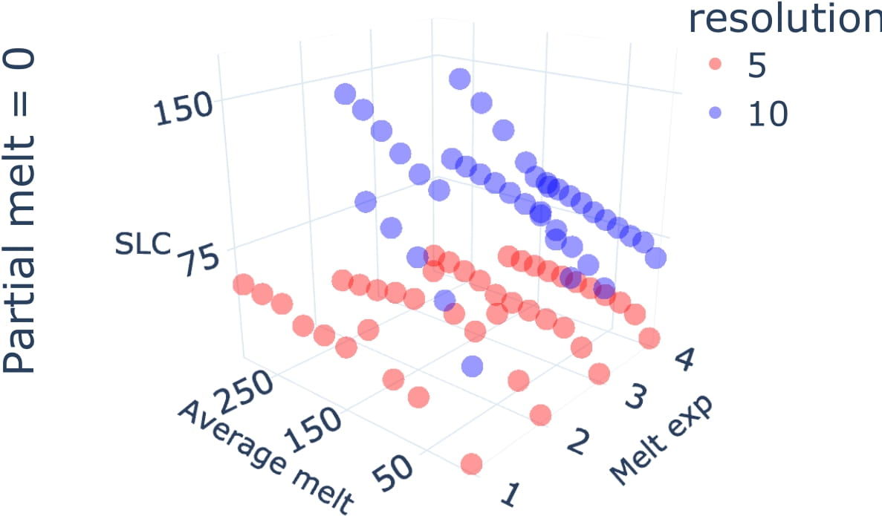
Ice-sheet data

Slide 14
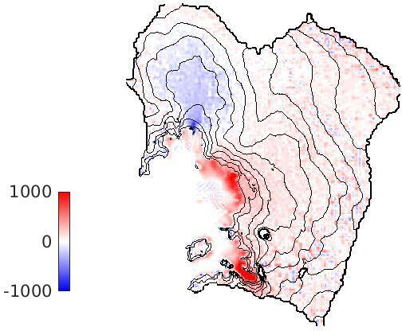
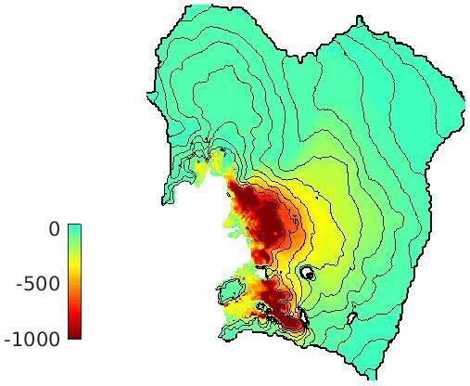
RESOLUTION DEPENDENCY
Left: modelled ice thickness change (in metres) over 100 years. Right: the difference in modelled ice thickness between a 10 km and a 3 km simulation.

Slide 15
ML agenda
Intro to multi-fidelity experimental design (MFED)
Theoretical insights
Jupyter notebook applying MFED to simple PDE
Interesting projects and extensions
Notes:
Need to add somewhere. Combination of sensitivity analysis and experimental design.
Combine lecture 4 and 5

Slide 16
TOY EXPERIMENT
Problem: learn SLC when varying temperature [0,10] atmosphere. Resolution 5 or 10k
Option A: 1 sample at 5km resolution (5 degree)
Option B: 2 samples at 10km resolution (3 and 7 degree)
Depends on the accuracy of the low resolution. but there is a threshold where you would choose one over the other (need to hide this one). Need a model !

Slide 17
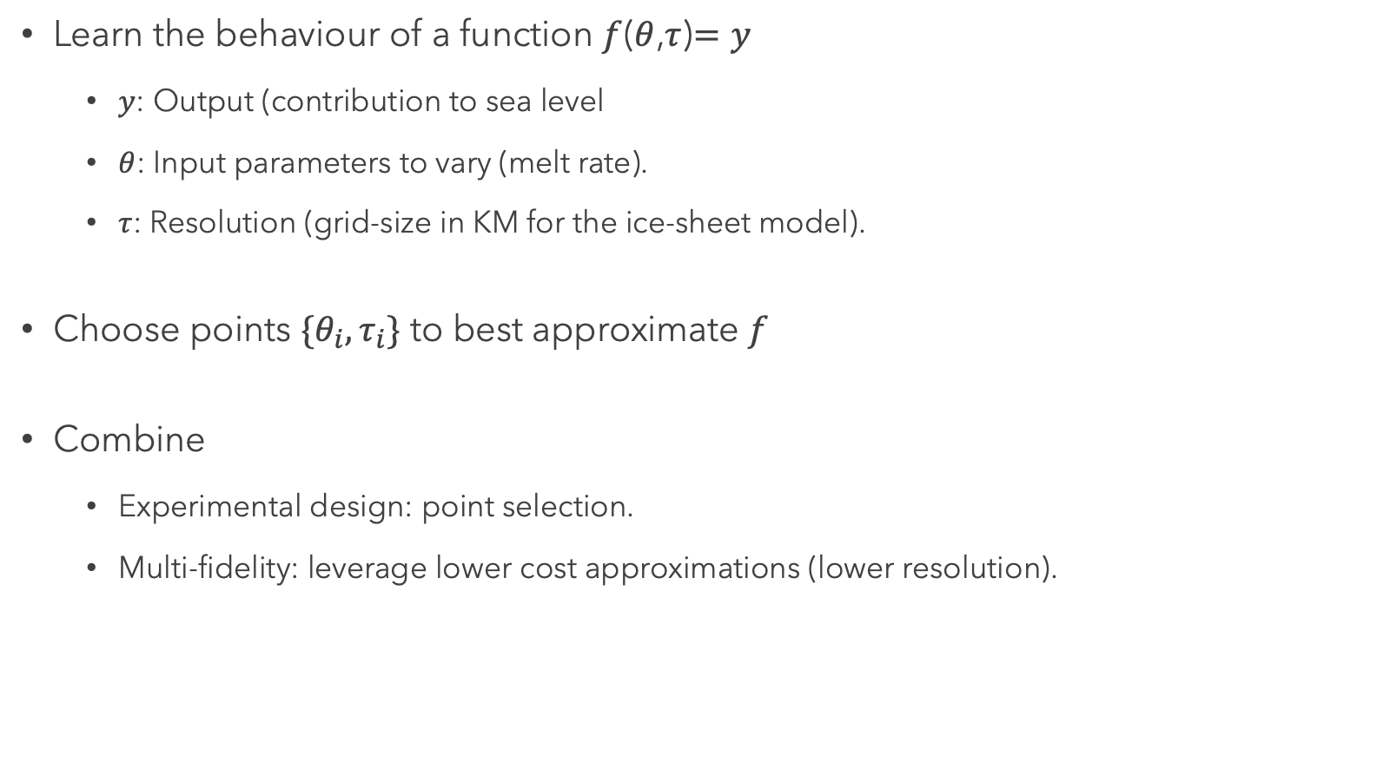
Objective
Learn the behaviour of a function $f$($θ$,$τ$)$=y$
$y$: Output (contribution to sea level
$θ$: Input parameters to vary (melt rate).
$τ$: Resolution (grid-size in KM for the ice-sheet model).
Choose points $\{θ_{i},τ_{i}\}$ to best approximate $f$
Combine
Experimental design: point selection.
Multi-fidelity: leverage lower cost approximations (lower resolution).

Slide 18
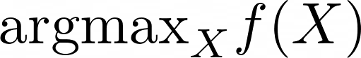
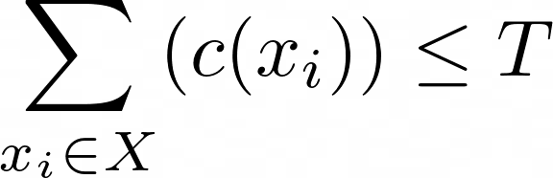
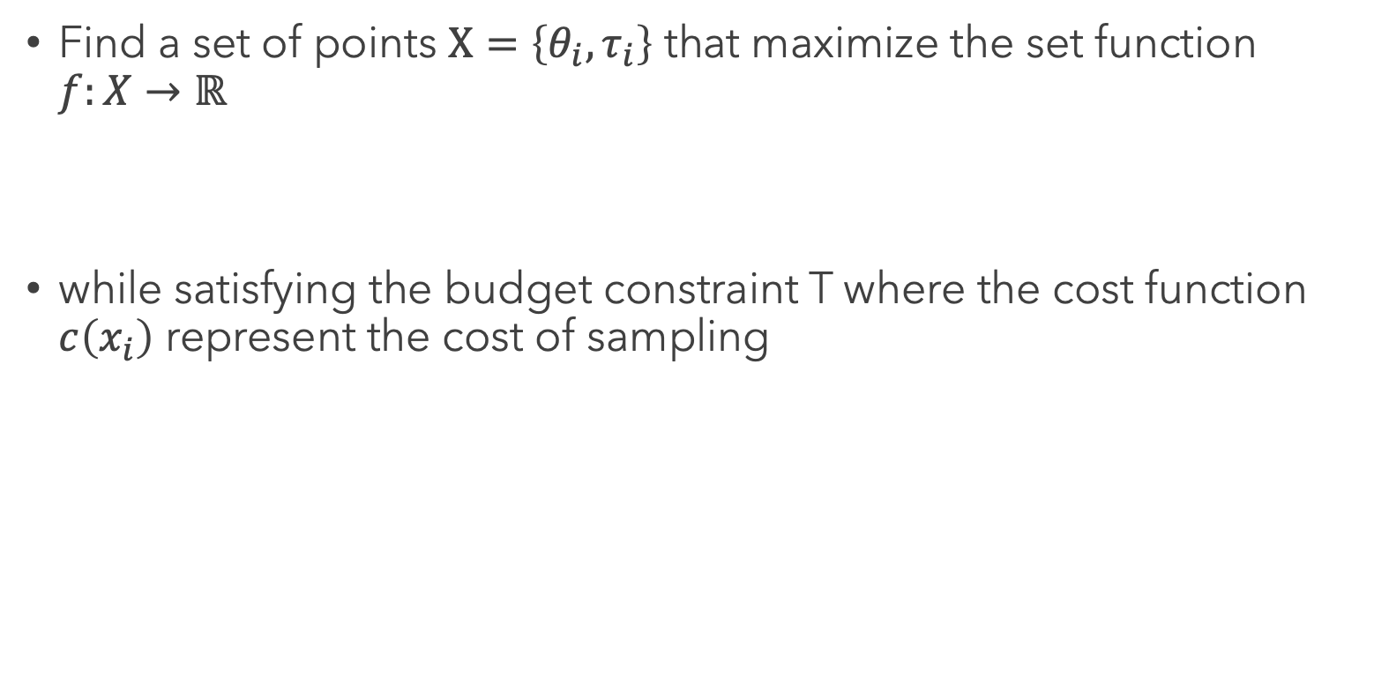
Constrained objective
Find a set of points $Χ=\left\{θ_{i},τ_{i}\right\}$ that maximize the set function $f:X→ℝ$
while satisfying the budget constraint T where the cost function $c\left(x_{i}\right)$ represent the cost of sampling

Slide 19
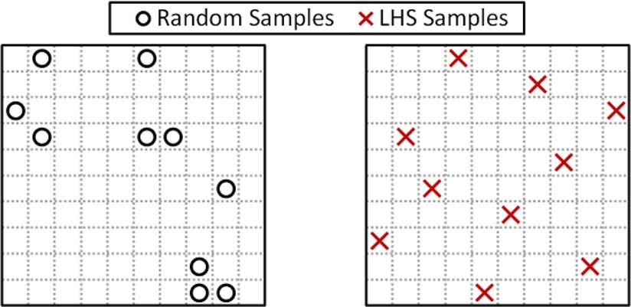
Refresher: Experimental design
Goal: choose input points to learn as much as possible about a function.
Space-filling design: choose points that maximize a distance metric between points
Latin hypercube sampling

Slide 20
Issue with space-filling design
Fail to model that have non-stationary behavior.
Part of the space might be more complex to model and require finer grain resolution
Hard to input user requirements
In ice-sheet we might only care about areas of the function above a certain threshold
Does not assign a value to a point which makes it complicated to adapt when comparing points of different resolutions (more on that later)

Slide 21
Model-based ED
Fit a probabilistic model (GP) of f on the datapoints collected.
Select points to minimize the uncertainty of the GP
Integrated variance reduction
See lecture 4 if you have any doubt
Add emukit graph

Slide 22
REFRESHER: Discrete Multi-fidelity
Add equations multi-fidelity
Discrete set of fidelities
Model relationship between fidelities

Slide 23
Continuous Multi-fidelity
Numerical solvers use time-discretization to solve complex systems that don’t have closed form
Accuracy is completely correlated with dt.
How sensitive is the solution to the discretization?
Continuous set of fidelities
View lower resolution as multi-fidelity problem. How can you combine varying degrees of accuracy to obtain output in a cost-efficient manner
Difference between discrete multi-fidelity and continuous
Lower fidelities are noisy version of the higher one ( add a graph?)

Slide 24
Multi-fidelity experimental design
Modeling
How do you model the function as well as the relationship between resolutions ?
What is the utility to optimize?
Decision-making
How do you choose the next point based on the model?
BO, RL, Online learnig, bandits (all connected)…

Slide 25
model
Model the resolution and parameter dimension continuously.
RBF kernel. Key parameter is lengthscale
Add plots

Slide 26
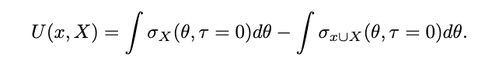
Utility: Conditional integrated variance
Integrated variance at the highest resolution possible.
Points at lower resolution are not useful on their own. With a model we can make predictions at high resolution that are useful

Slide 27
utility maximization
Querying the highest fidelity obviously has the highest reward.
We need to adjust the the utility based on the costs
Constrained optimization problem with a fixed computational budget.
Graph on the right

Slide 28
Planning is hard
Combinatorial choices between all the points.
Utility of a point is not fully known and changes through the process as we fit the lengthscale
We might believe low resolution points are useful at the beginning but realize they are not at the end.

Slide 29
Greedy approximation: Weighted utility
Approximate the planning strategy by myopically selecting the point that maximize the following metric:
Add equation
Need to know the cost of each point (or a model)
Biased as it’s a myopic approximation to the planning problem.
Now we have a way to select points

Slide 30
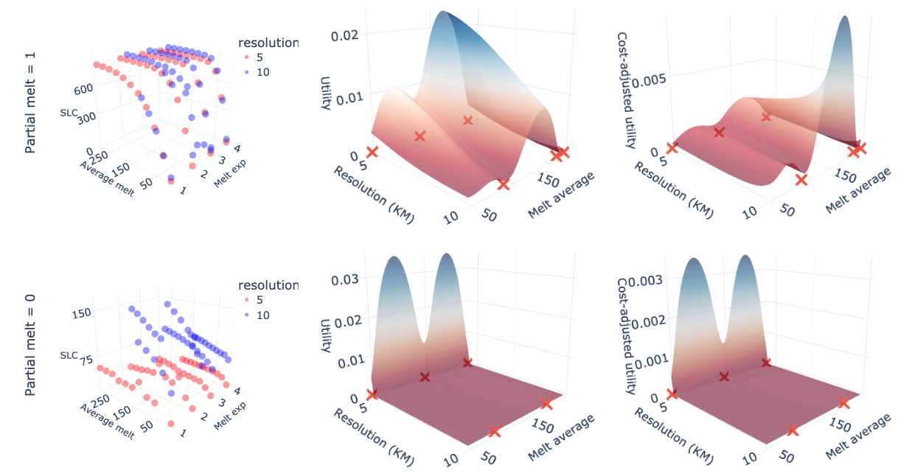
UTILITY on ice-sheet data

Slide 31
Intuitive: How to assign value to a resolution ?WHAT IS THE UNDERLYING MODEL?
Add in the slide: when sampling. relying on a model to extrapolate.
Question how far can you extrapolate. Can extrapolate along parameter axis.
But what about the computational axis? If you use space-filling how do you compare runs at different resolutions? need to build a model.
Lets build a model both for parameter and computational axis.
Equivalence in prediction in either direction if lengthscale is the same.
Whole point is learning lengthscale in this case.
But can now decide between parameter or compuational focus, quite cool
Could make example of surface being similarly impacted

Slide 32
RECAP
We have a function f that takes as input external parameters \theta and resolution \tau.
We want to find points {\theta_i,\tau_i} such as to reduce the uncertainty of our probabilistic estimate of f.
ED defines the utility of a point as integrated variance reduction.
We extend this definition to incorporate the cost of a point (multi-fidelity) to obtain cost-efficient ED.

Slide 33
Analysis of the greedy approximation
2 parts. The modelling part (GP) and the decision making part (RL, online learning BO ect…)
Modelling is GP we use, utility
Decision-making is greedy approximation planning, how to deal with uncertainty over model.

Slide 34
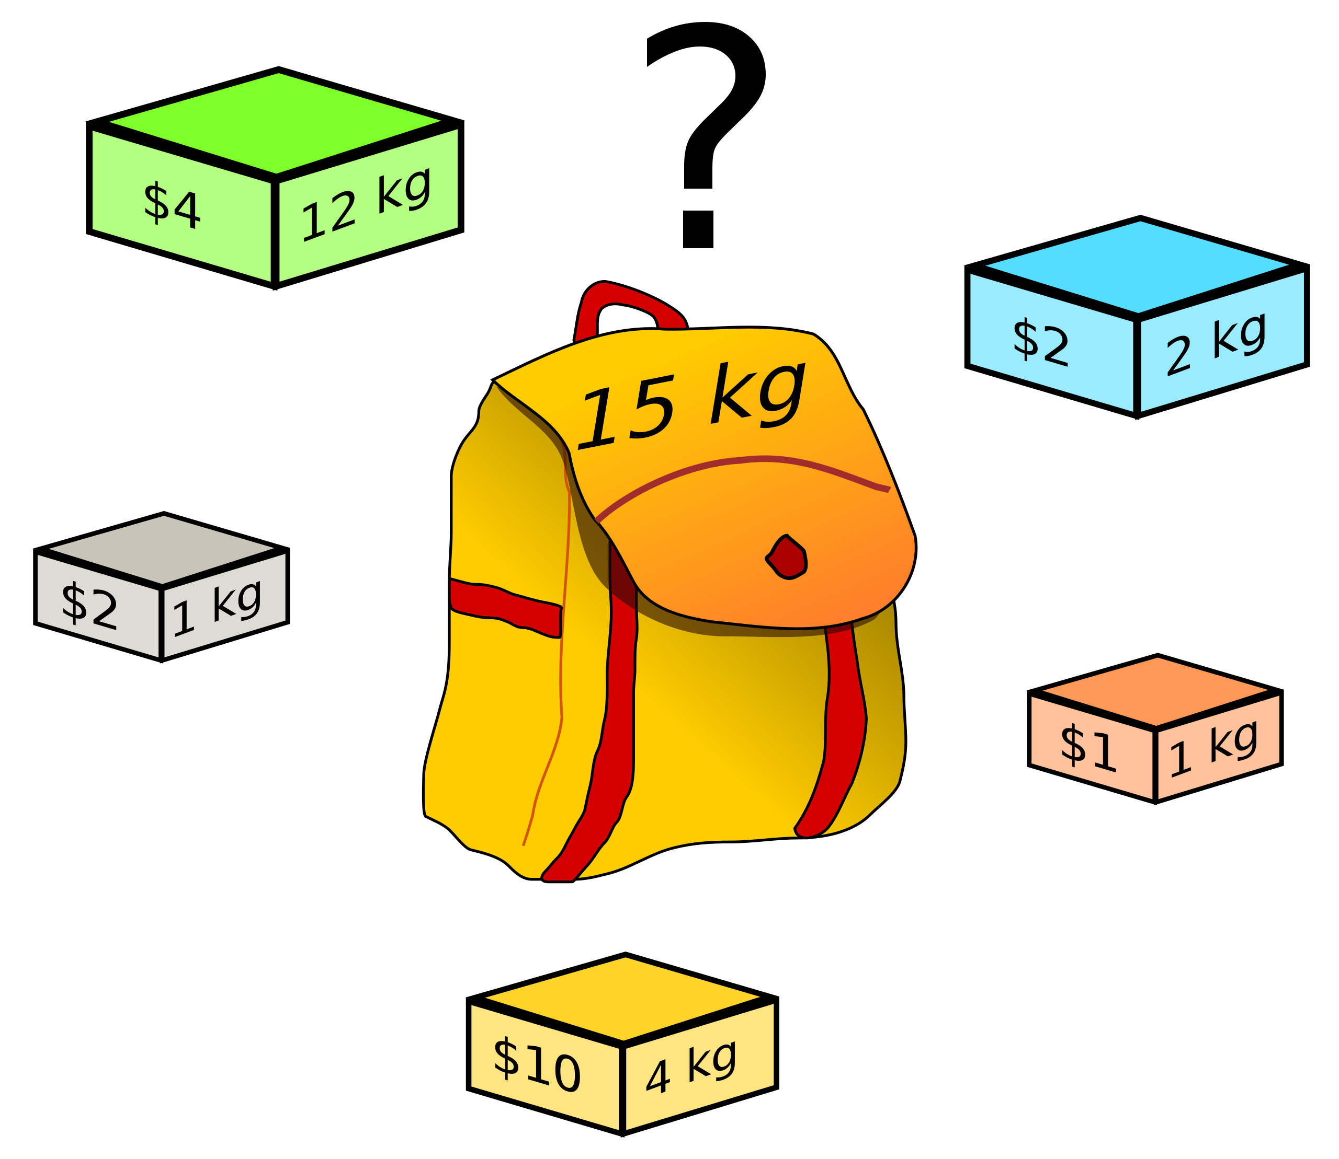
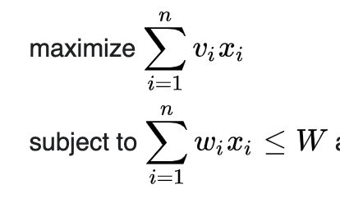
KNAPSACK PROBLEM
Combinatorial optimization problem
Discrete variant of our problem

Slide 35
GREEDY APPROXIMATION
Greedy approximation is good: utility/cost
Can prove the following performance bound

Slide 36
Set maximization & Sub-modularity
MFED is a set maximization problem (math def)
Slightly different but the same theory applies if the function satisfies sub-modularity
Definition sub-modularity (CIV satisfies)

Slide 37
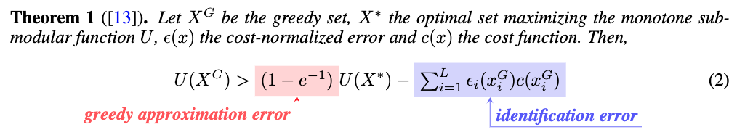
Regret of stochastic greedy strategy
One more complexity is we don’t know the value of each point really because the lengthscale is unknown. So noisy version of sub-modularity.

Slide 38
Experiments
Apply MFED to PDE and ODE (notebook)
More extensive result for ice-sheet model (work in progress)

Slide 40
A few directions
Apply this to interesting applications
Myopic behavior is bad? Talk about myopic formulation?
Greedy behavior is bad? Talk bandit formulation. HMC. Adding exploration bonus.
More interesting modelling choices (non-stationary kernel? And its implications)?
Resolution quality trade-off is everywhere. Make computation related problem data driven !
Comparison with other strategies/baselines?

Slide 41
Interesting applications
Can work on any large scale simulator.
Resolution quality trade-off is everywhere. Make computation related problem data driven !
Basically mention my thesis
Ice-sheet simulator is available in Julia but can be a bit tricky to work with. If you’re interested in working on that let me know.

Slide 42
Myopic behavior
Add picture.
Samples one in a row. Weird behavior
Need planning

Slide 43
Optimism in the face of uncertainty
When selecting a sample we don’t assume we learn anything new about lengthscale
Estimate gets better through time and that has value
Can add exploration bonus, or use probabilistic modelling UCB style

Slide 44
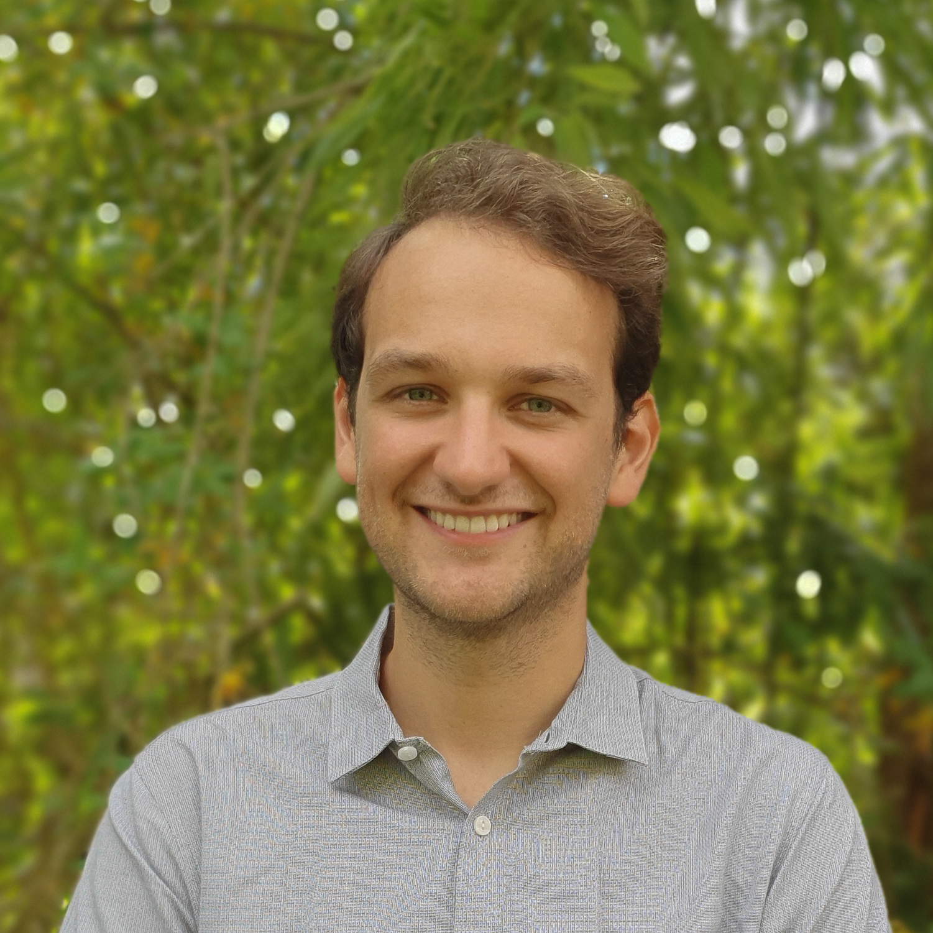
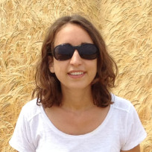
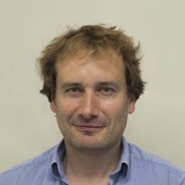
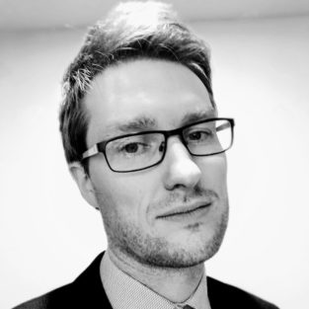
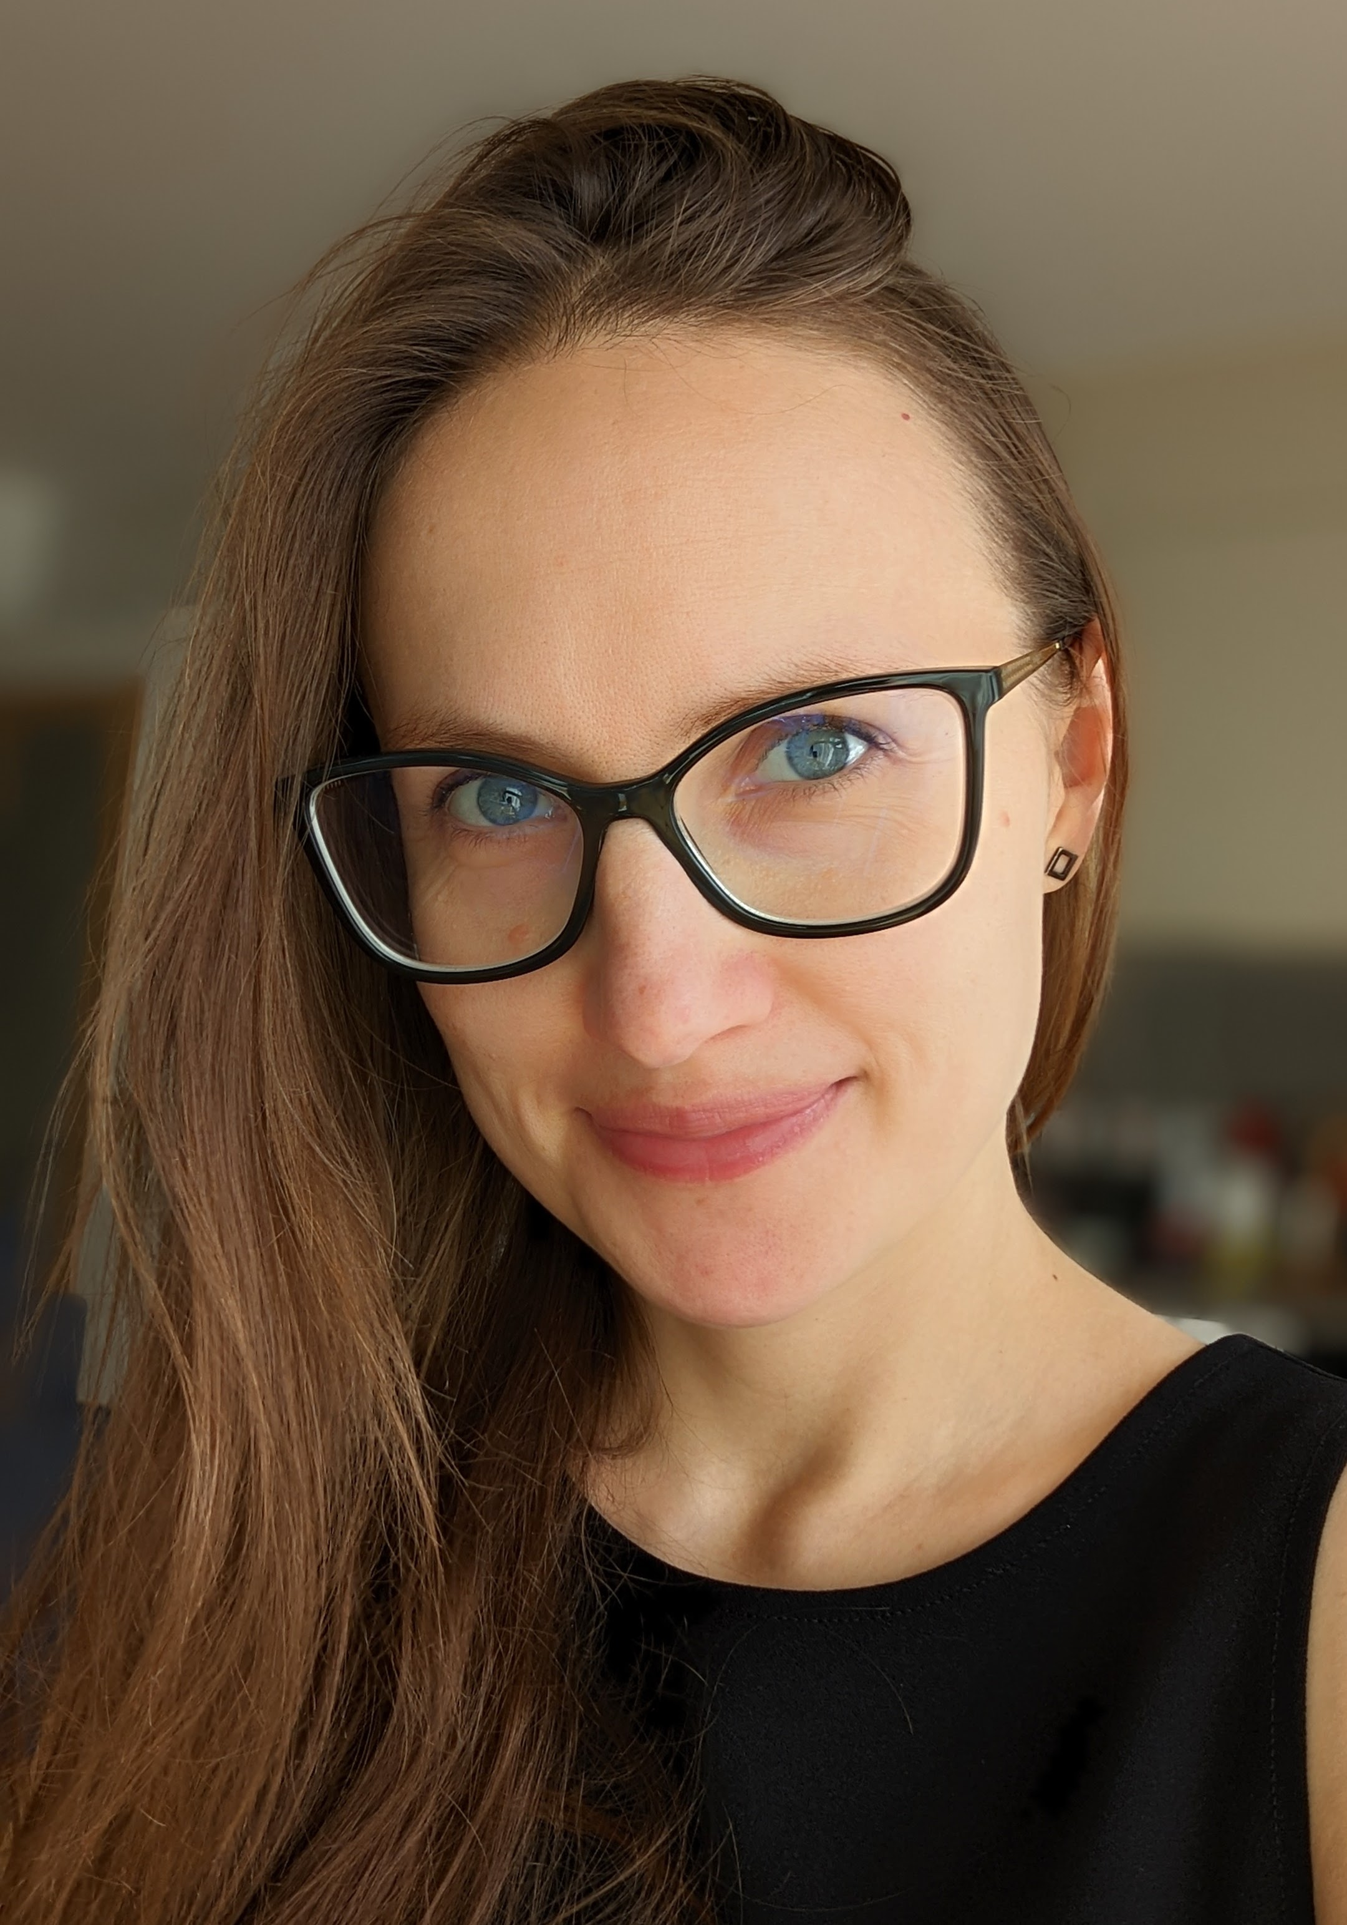
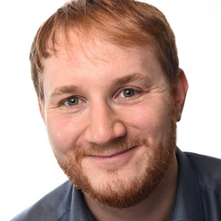
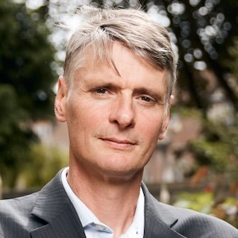
OUR TEAM
Pierre Thodoroff
Rosie Williams
Robert Arthern
Scott Hosking
Computer Lab at the University of Cambridge
British Antarctic Survey
British Antarctic Survey
British Antarctic Survey
Ieva Kazlauskaite
Marcus Kaiser
Neil Lawrence
Department of Engineering at the University of Cambridge
Computer Lab at the University of Cambridge
Computer Lab at the University of Cambridge

Slide 45
THANK YOU!
Pierre Thodoroff
pt440@cam.ac.uk

Slide 46
References
Experimental design sampling: https://www.researchgate.net/publication/276113319_Efficient_Estimation_of_the_Probability_of_Small-Disturbance_Instability_of_Large_Uncertain_Power_Systems

Slide 47

Reference
RICHARD BRANSON

Slide 48
References

Slide 49

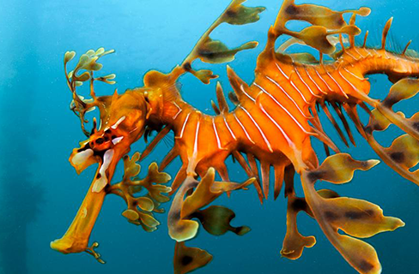
INTRODUCTION
At Contoso, we empower organisations to foster collaborative thinking to further drive workplace innovation. By closing the loop and leveraging agile frameworks, we help business grow organically and foster a consumer-first mindset.

Slide 50
Business opportunities are like buses. There's always another one coming.
RICHARD BRANSON

Slide 51
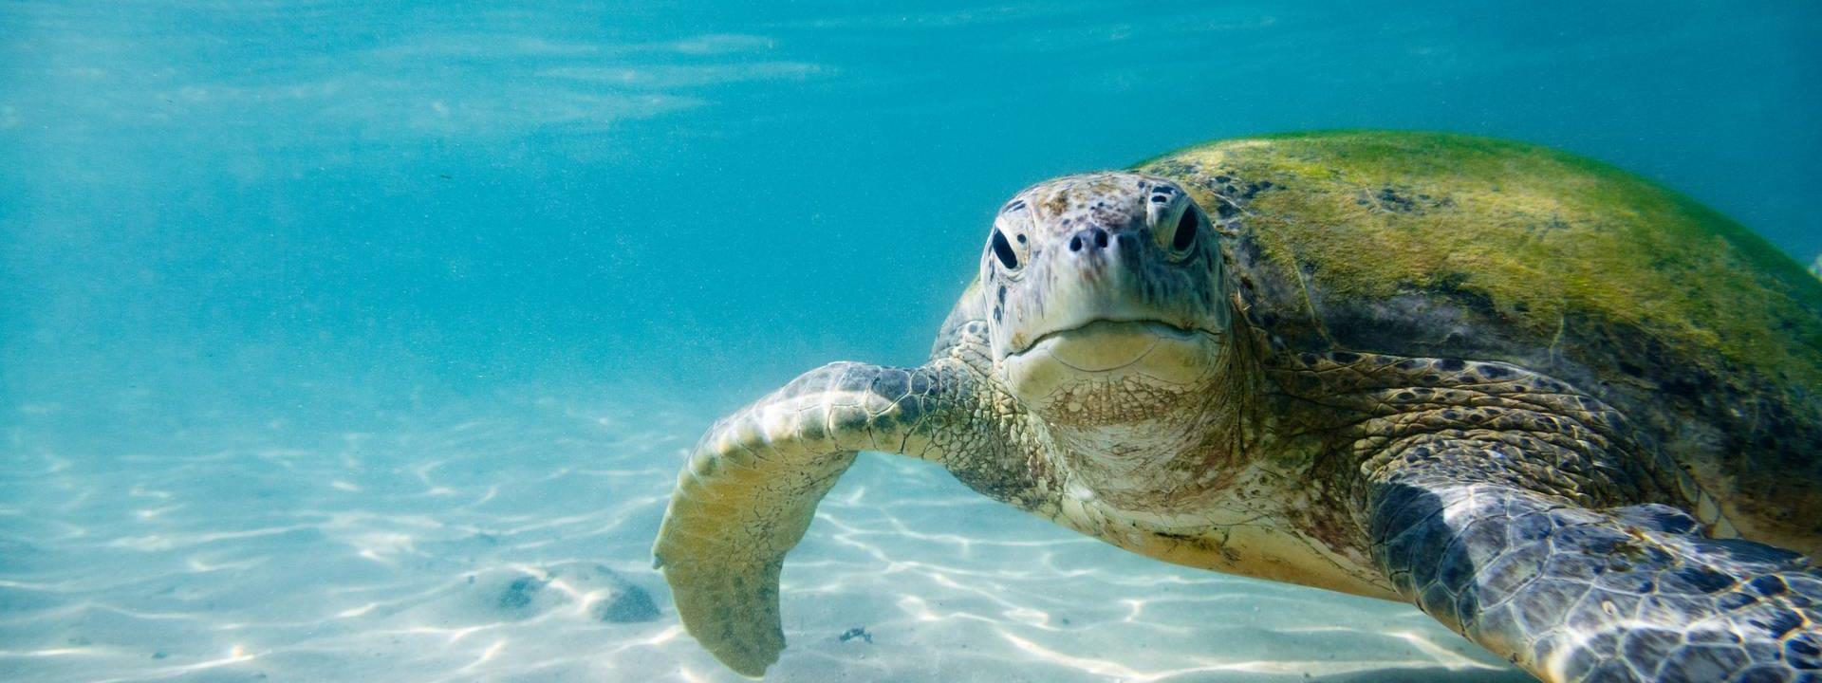
PRIMARY GROWTH
Areas of focus

Slide 52
QUARTERLY PERFORMANCE

Slide 53
Areas of growth
 | B2B | SUPPLY CHAIN | ROI | E-COMMERCE
Q1 | 4.5 | 2.3 | 1.7 | 5.0
Q2 | 3.2 | 5.1 | 4.4 | 3.0
Q3 | 2.1 | 1.7 | 2.5 | 2.8
Q4 | 4.5 | 2.2 | 1.7 | 7.0

Slide 54

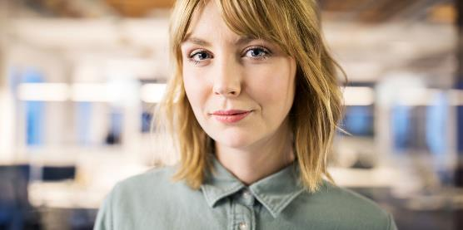


OUR TEAM
TAKUMA HAYASHI
MIRJAM NILSSON
President
Chief Executive Officer
FLORA BERGGREN
RAJESH SANTOSHI
Chief Operations Officer
VP Marketing

Slide 56
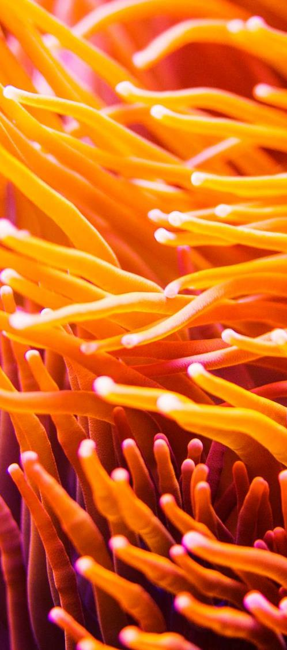
AREAS OF FOCUS
B2B MARKET SCENARIOS
CLOUD BASED OPPORTUNITIES
Develop winning strategies to keep ahead of the competition
Capitalize on low hanging fruit to identify a ballpark value
Visualise customer directed convergence
Iterative approaches to corporate strategy
Establish a management framework from the inside

Slide 58
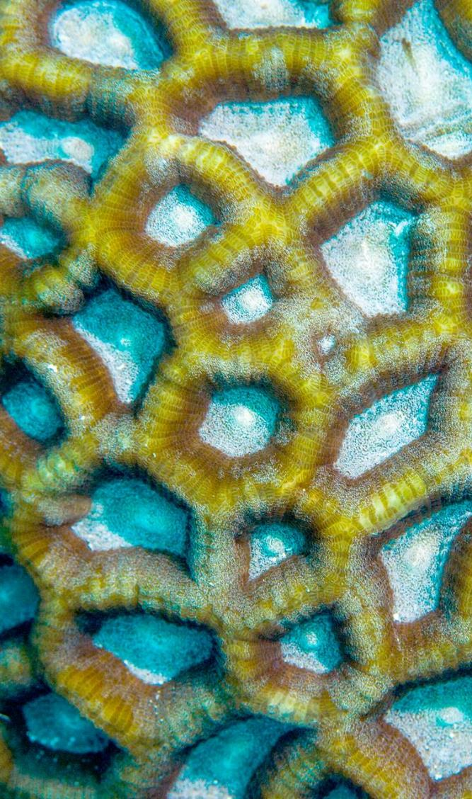
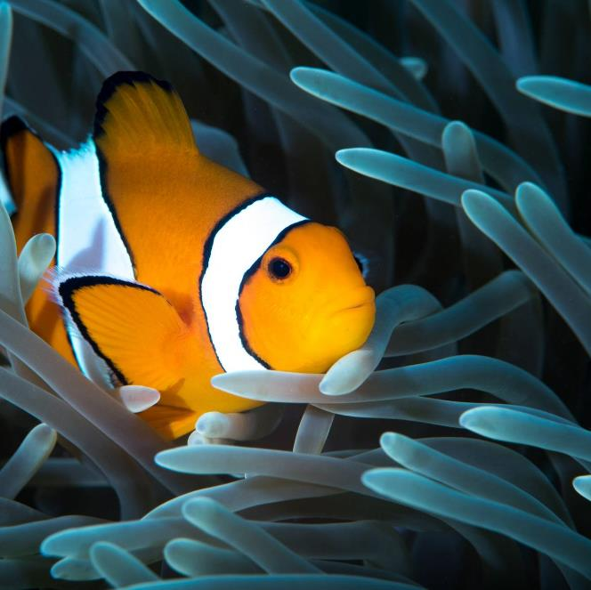
SUMMARY
At Contoso, we believe in giving 110%. By using our next-generation data architecture, we help organisations virtually manage agile workflows. We thrive because of our market knowledge and great team behind our product. As our CEO says, "Efficiencies will come from proactively transforming how we do business."

